Slide 1
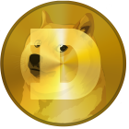
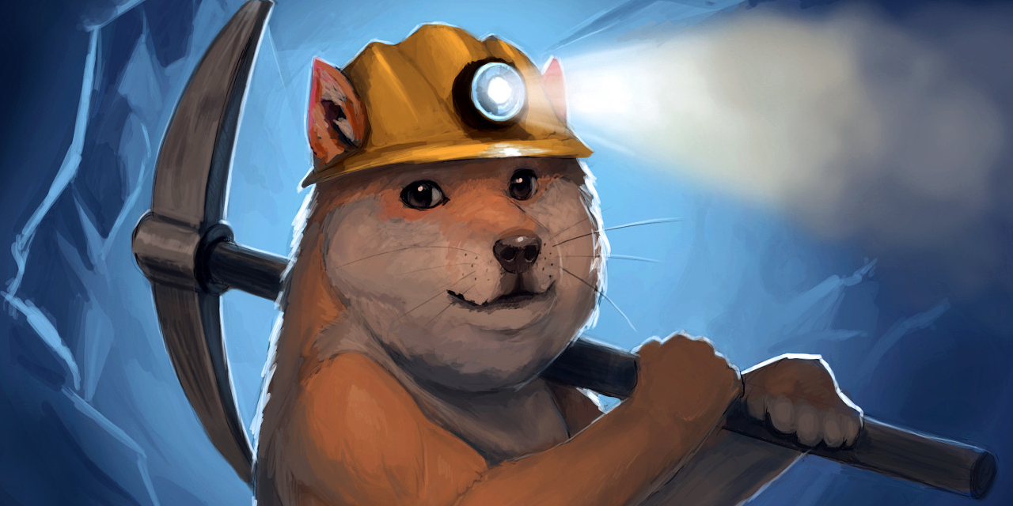
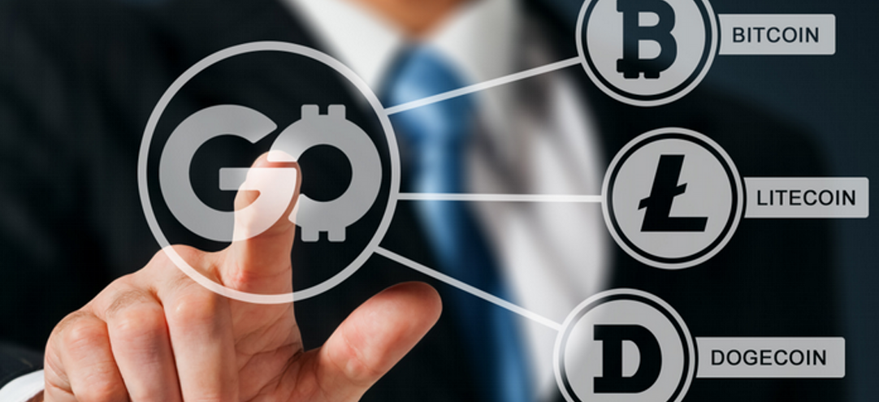
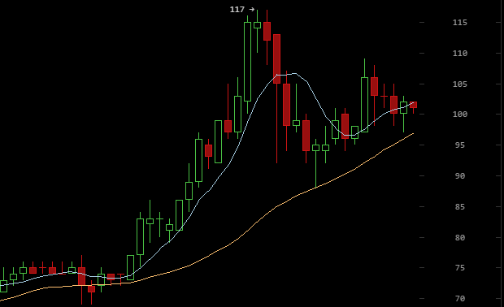
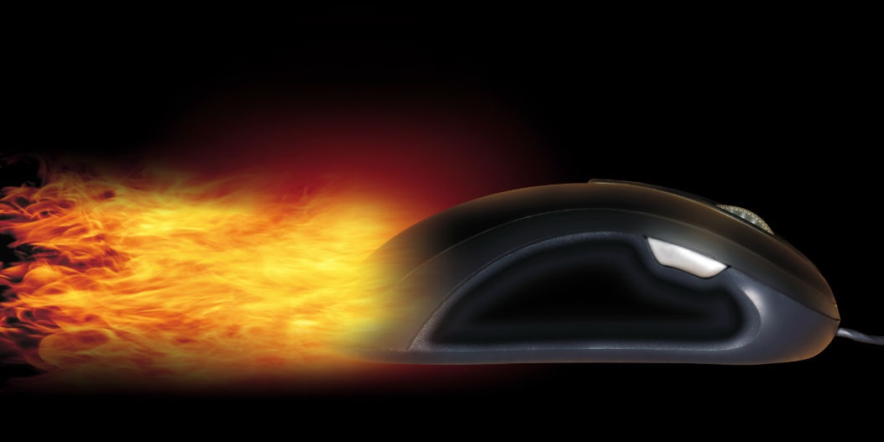
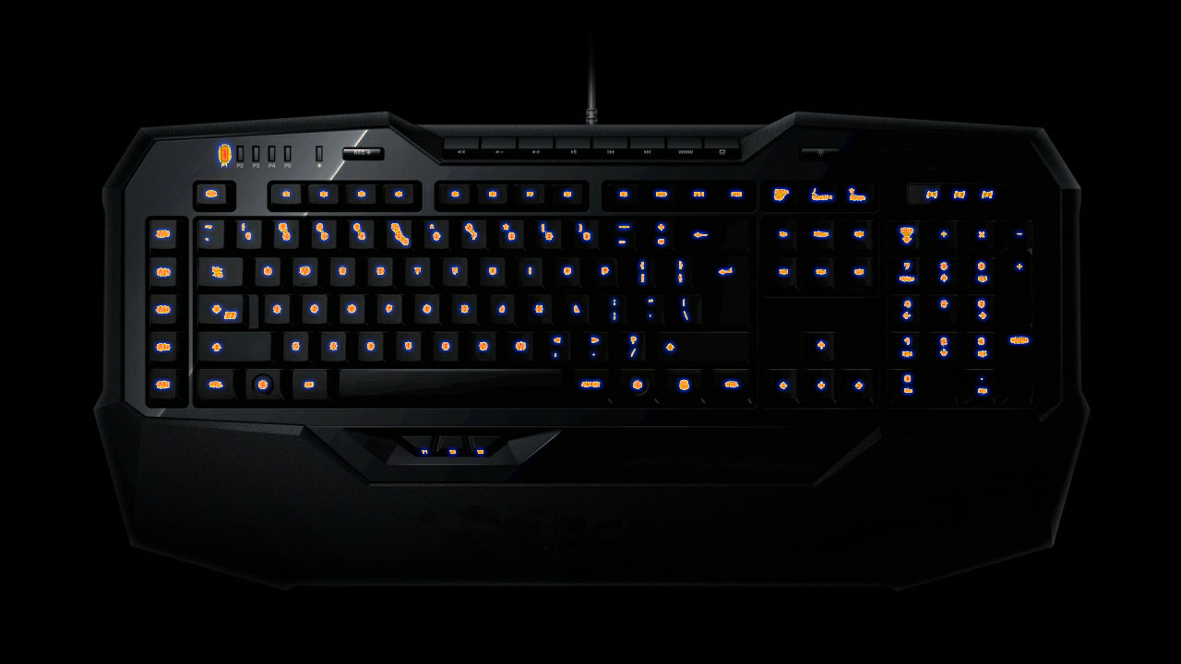

This week in Dogecoin
September 22nd to 29th 2014
Dogecoins network hash rate reached a new high this week passing one Tera Hash further securing the network for all Dogecoin users. Dogecoins hash rate sharply increased after the Dogecoin 1.8 update earlier on in September.
Mining
Gocoin’s CEO Steve Beauregarf announced on twitter there would be a partnership with PayPal allowing Dogecoin to be used at merchants who accept PayPal. This may have contributed to a jump in markets shortly afterwards the announcement.
Business
Dogecoins market price continued to rise this week peaking at 117 Satoshis then stabilizing to 100 Satoshis. This is the first time in several months Dogecoin has broken the 100 Satoshi mark.
Dogecoins market cap also increased to over $40M USD dollars USD for a short time.
Market
Reddits Dogecoin online forum supported community member Josh Wise for grand final of the Nascars Hottest driver awards.
Josh wise totaled 83% to beat Tony Stewart finishing with only 17% of the votes. Another community member elleyonn won this months round for Miss Maxim Korea.
Voting
Doge4esports raised over 10million Dogecoins and worked with hsel.org to sponsor a twitch online gaming champion ship. This times itself well with the release of a doge coin tipping tool now being used on twitch after being used on reedit.com over the past eight months and gaining 65,000 users.
Gaming
Australian V8 Supercar driver Jack Lebrocq completed a reddit IAMA this week. Jack will be driving in the highly anticipated Dunlop Series mini 250km event. Bathurst draws upwards of 150,000 visitors. After the success of Doge4nascar this would be another opportunity to put a Dogecoin logo on a racecar.
Funding
Mining: http://redd.it/2h441i Business: http://goo.gl/XtiSDX Market: bitcoinwisdom.com
Voting: http://goo.gl/FxPyZA Gaming: http://redd.it/2hgn6f Funding: http://redd.it/2hou74 http://redd.it/2hlcci doge4esports.com http://goo.gl/S5qSOg

